Slide 1

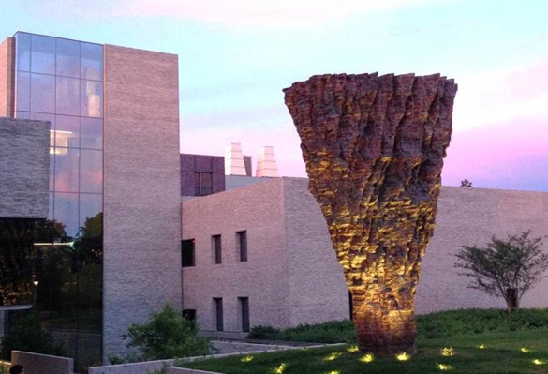
Imaging and Analysis Center (IAC)
Princeton University
Nan Yao, IAC Director

Slide 2
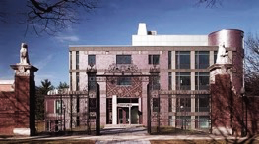
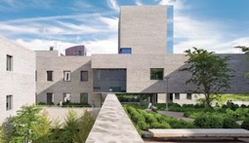
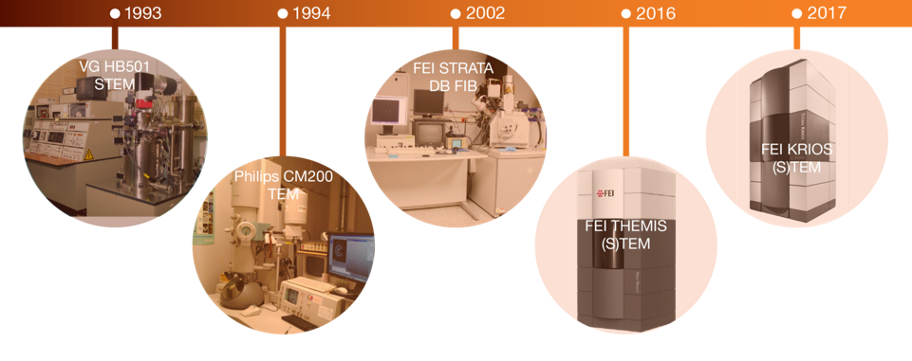
Imaging and Analysis Center (IAC) at Princeton University
VG HB501 STEM
Cameca SX-50 Microprobe
Strata DB-235 DB-FIB
Philips XL30 SEM (EDX)
Philips CM100 TEM
Rigaku MiniFlex XRD
Bruker D8 XRD
Bruker Multimode AFM
Bruker Nanoman AFM
FEI Quanta ESEM (EDX, WDX, EBSD)
Themis (S)TEM (Cs^{2,} EDX, EELS)
Krios Cryo-TEM (Cs, K2, Phase plate)
Talos (S)TEM (EDX)
Verios HRSEM (EDX)
Helios DB FIB (EDX)
Thermo K-Aalpha XPS/UPS
Bruker Icon3 AFM
Zeiss Versa 520 3D X-ray
Perkin Elmer DMA, TGA/GC
Anton Paar MCR 702
Rheometer, Nicolet IN10 MX FTIR
Philips CM200 FEG-TEM
Horiba Raman
Leica Confocal DMC optical
Woollam M-2000 Ellipsometer
Notes:
Largest share facility, one of good example of MRSEC funded in 1994
Education
Industry outreach

Slide 3
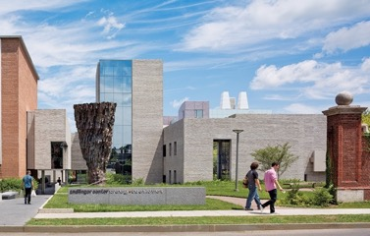
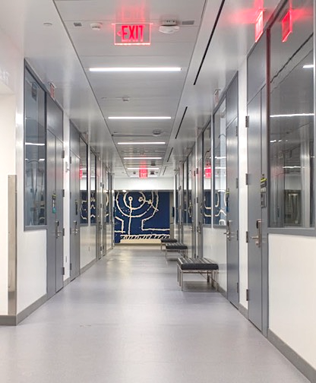
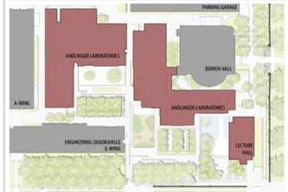
IAC labs in the new Andlinger building
Home of the Imaging and Analysis Center that meets NIST’s highest standards for environmental
- control, including EMI, vibration isolation, etc. IAC ‘s new lab space is ~7,500 sq.ft.

Slide 4
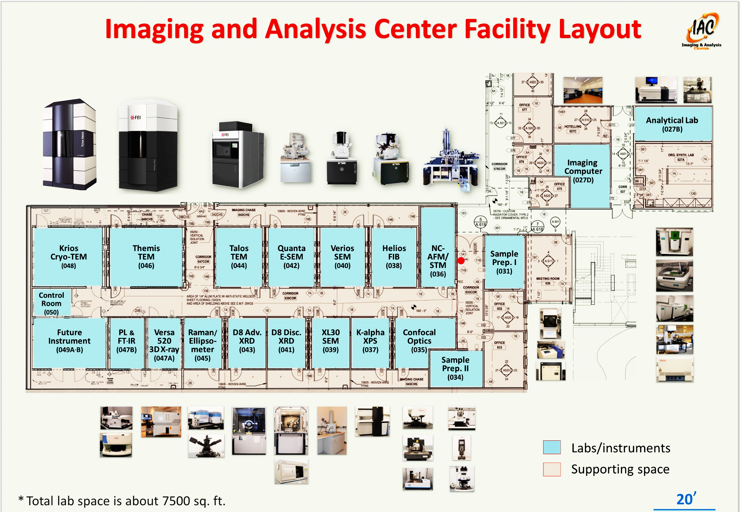

Slide 5
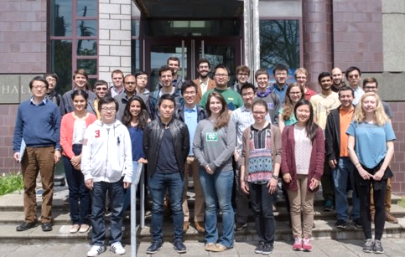
IAC supports research and education at Princeton
MSE505 S2017
IAC users, 2013-17
2013 2014 2015 2016 2017
MSE505 – Characterization of Materials (taught in the IAC) has been named eight times on the Princeton Engineering Commendation List for Outstanding Teaching. IAC also supports 12 regular courses, (7 undergraduate and 5 graduate).
IAC’s training courses (29 topics) on the use of analytical instruments have > 300 enrollees each year.
More than 250 Princeton regular users include (> 40 undergraduate students, > 130 graduate students, 70 faculty and postdocs in 2016-17); Users are funded by ~220 research grants/contracts.
IAC users are from 17 departments and centers on campus [Chemical and Biological Engineering, Chemistry, Civil and Environmental Engineering, Ecology and Evolutionary Biology, Electrical Engineering, Energy and the Environment (ACEE), Geosciences, History, Mechanical and Aerospace Engineering, Molecular Biology, Neuroscience, Physics, Plasma Physics Labs (PPPL), Princeton Art Museum, PRISM, School of Architecture, and Firestone Library.

Slide 6
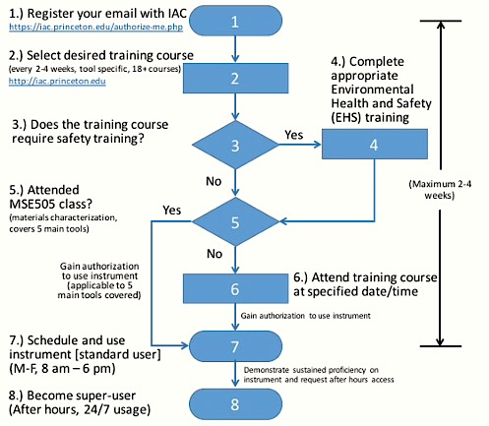
Procedure for using instrument in the IAC
IAC holds 2-4hr mini-courses almost every day, open to all industrial scientists with free of charge
Each course taught at least once per month with online registration and tool reservation
Opportunities for students directly interact with industrial scientists
http://www.princeton.edu/~iac

Slide 7
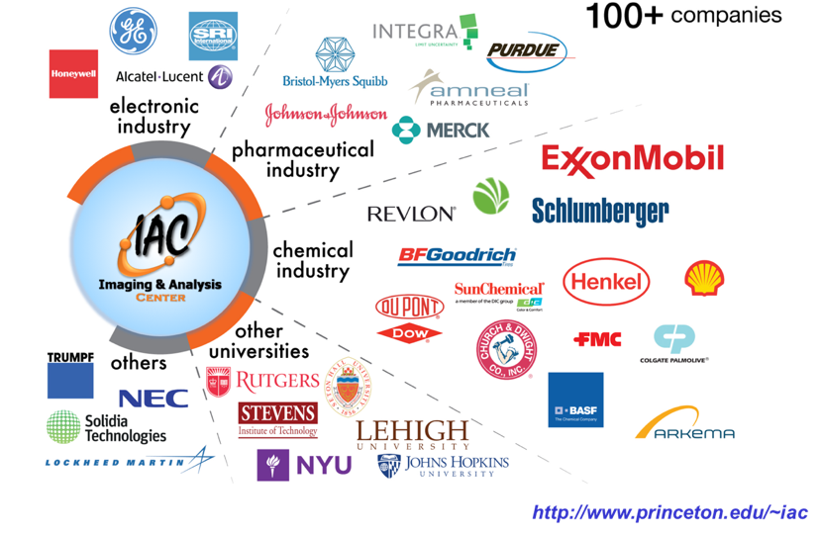
IAC’s long standing partnership with industry

Slide 8
Continued growth of industrial users in the IAC
Industrial
Academia
2013 2014 2015 2016 2017
Plot shows steady growth of # of IAC external users over the past few years.
IAC external users are from more than 110 industrial companies and 20 education institutions. They engaged about 15% of machine usage and contributed more than 50% in total users fees.
Note: 2016- 2017 new (including renewed) users are marked in red.
http://www.princeton.edu/~iac

Slide 9
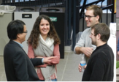
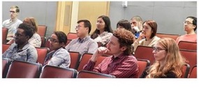
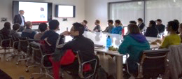
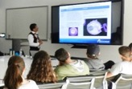
The PCCM Industrial Seminar Series
PCCM’s new industrial seminars - a monthly seminar series for Princeton materials community. Guest speakers include former CEO of AIChE, industrial scientists, IP attorneys, and entrepreneurs from BMS, ExxonMobil, Johnson & Johnson, Merck, and many startups.
Students comments include:
“The Industrial Seminar Series has differentiated itself from regular departmental seminars and it has been great for students looking to enter industry. They are extremely useful in learning what to expect in the industrial sector.” (Geoff Purdum)
“This seminar is extremely valuable in promoting academic-industrial partnerships and collaboration as well as exposing students, faculty, and postdocs to research and opportunities outside of academia.” (Mary Burroughs)
“ … gave us the unique chance to see research from a different perspective. The broad range of topics from pharmaceutical research to intellectual property showed the variety of opportunities available in industry to Princeton students.” (Victoria Lee)

Slide 10
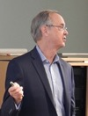





The PCCM Industrial Seminar Topics and Speakers
(2016-18)
John Sofranko, Former CEO of AIChE,
Founder & CEO, EcoCatalytic Technologies, Bio2Electric, LLC
"Planning a successful technical career - leveraging breadth of experience and dumb luck”, 10/06/2016
Jeff Streger, Founder and Principal, Rave Scientific, Inc., "The Experience of a Start-up: Risk and Reward”, 11/17/2017
Paul Higgins, Assistant General Counsel - Patents
Johnson & Johnson,
"Intellectual property overview”,
03/3/2017
David Dankworth, Distinguished Scientific Advisor, ExxonMobil
"Misery and Mystery - Unexpected Materials in Petrochemical Processes”, 01/19/2018
Ashley Moore, Staff Scientist, EMD Performance Materials, Merck, "Early stage research: Feasibility & technology development”, 04/07/2017
Srini Sridharan, Director, Materials Science & Engineering, Bristol-Myers Squibb, "The role of materials characterization and its importance in the development of medicines”, 02/16/2018
…...
Notes:
A primary objective of the PCCM industrial outreach program is to build bridges that directly connect Princeton’s researchers with industrial scientists. We have established a new industrial seminar series (see link: http://pccm.princeton.edu/collaboration) inviting industrial scientists to deliver lectures on campus. The program is mutually beneficial to all – students gain valuable insight into industrial practice, while speakers have the opportunity to learn about campus research and meet potential colleagues. Our speakers have included: a former CEO of the American Institute of Chemical Engineers (AlChE), process engineers, laboratory director, intellectual property attorney, and entrepreneur from a wide range companies; their employers have included: BMS, ExxonMobil, Johnson & Johnson, Merck, and startups. This program has been well received by our faculty, postdoctoral scientists and students. Industrial seminars - a monthly seminar series for Princeton materials community. Invited speakers include former CEO of AIChE, industrial scientists, IP attorneys, and entrepreneurs from BMS, ExxonMobil, Johnson & Johnson, Merck, and startups.
Industrial seminars - a monthly seminar series for Princeton materials community. Guest speakers include former CEO of AIChE, industrial scientists, IP attorneys, and entrepreneurs from BMS, ExxonMobil, Johnson & Johnson, Merck, and many startups.

Slide 11
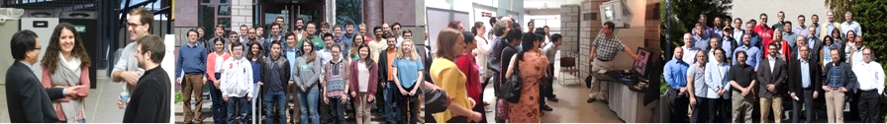
IAC’s long standing partnership with industry
Industrial workshops
Princeton–Anton Paar Advanced Rheology Workshop (49 attendees), September 20, 2016
Keyence VK-X Laser Scanning Microscopy Workshop (7 attendees), May 2, 2017
Princeton–Bruker Advanced Atomic Force Microscopy Workshop (33 attendees), May 10, 2017
Princeton materials students visit industry (Going-out)
Bristol-Myers Squibb Company visit by Princeton materials students, including graduate students and postdocs, November 8, 2016. (12 students)
ExxonMobil Company visit by Princeton materials students, April 20, 2017. (34 students)
Industrial scientists visit Princeton (Bring-in)
Trumpf Photonics Company visit PCCM-IAC on August 11th, 2016. (31 scientists)
ExxonMobil Scientists visited PCCM-IAC on May 3, 2017 ( > 50 scientists)

Slide 12

Princeton_Nature Conference:
Frontiers in Electron Microscopy for the Physical and Life sciences
Princeton, NJ, July 11-13, 2018
From Nature Research, a division of Springer Nature
Notes:
In recent years electron microscopy (EM) instrumentation and methods have significantly advanced. From Cryo-EM to aberration correction, and from low-energy holography to vortex beams, both the physical and life sciences have benefited greatly. Still, the instrumentation and methods used by both communities differ. With this conference we hope to bring together leading researchers in both the physical and life sciences to advance EM instrumentation and methods. Together, academia and industry can approach tomorrow’s challenges:
•Attracting hundreds of researchers from both academia and industry including IAC longstanding partners as well as many startups.
•Educating the scientific community across broad disciplines about the most advanced aberration correction and Cryo-EM.
•Inspiring the scientific community to utilize advanced electron microscopy in innovative ways to answer their scientific questions in Nature research.

Slide 13
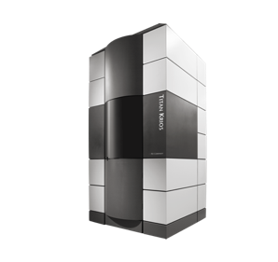
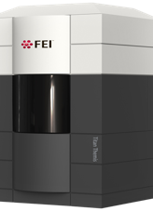
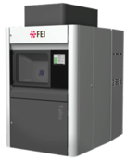
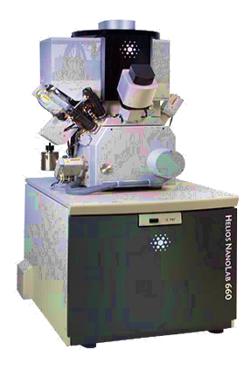
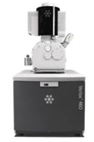
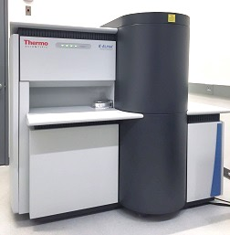
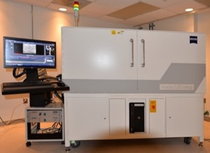
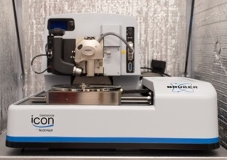
New tools in the Imaging and Analysis Center (since 2016)
Themis S/TEM
Krios Cryo-TEM
Talos TEM
Helios FIB
Verios SEM
K-alpha XPS/UPS
Versa 520 3D X-ray
ICON 3 AFM

